Slide 1

Docker Networking Overview

Slide 2
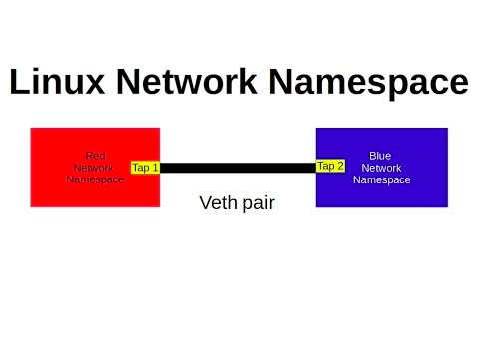
Linux network namespace
network namespace
routing table
firewall rules

Slide 3
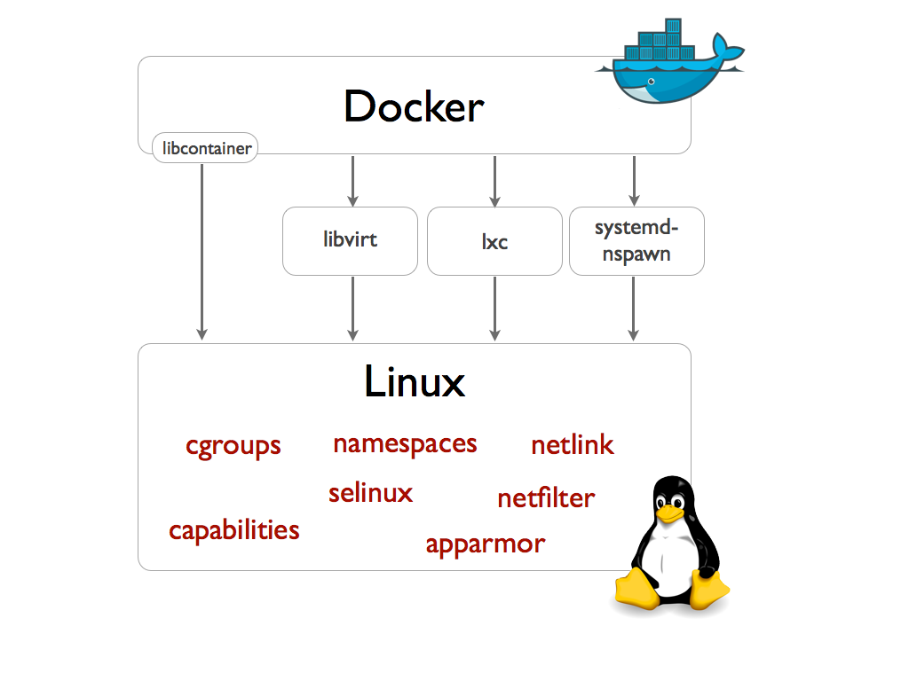
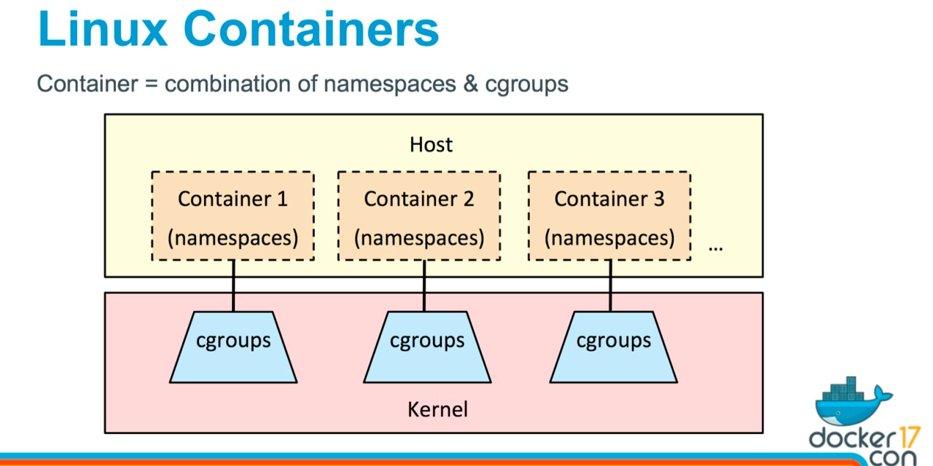
Linux docker host namespace
Notes:
https://zhuanlan.zhihu.com/p/43673419
https://blog.51cto.com/8493144/2044680

Slide 4
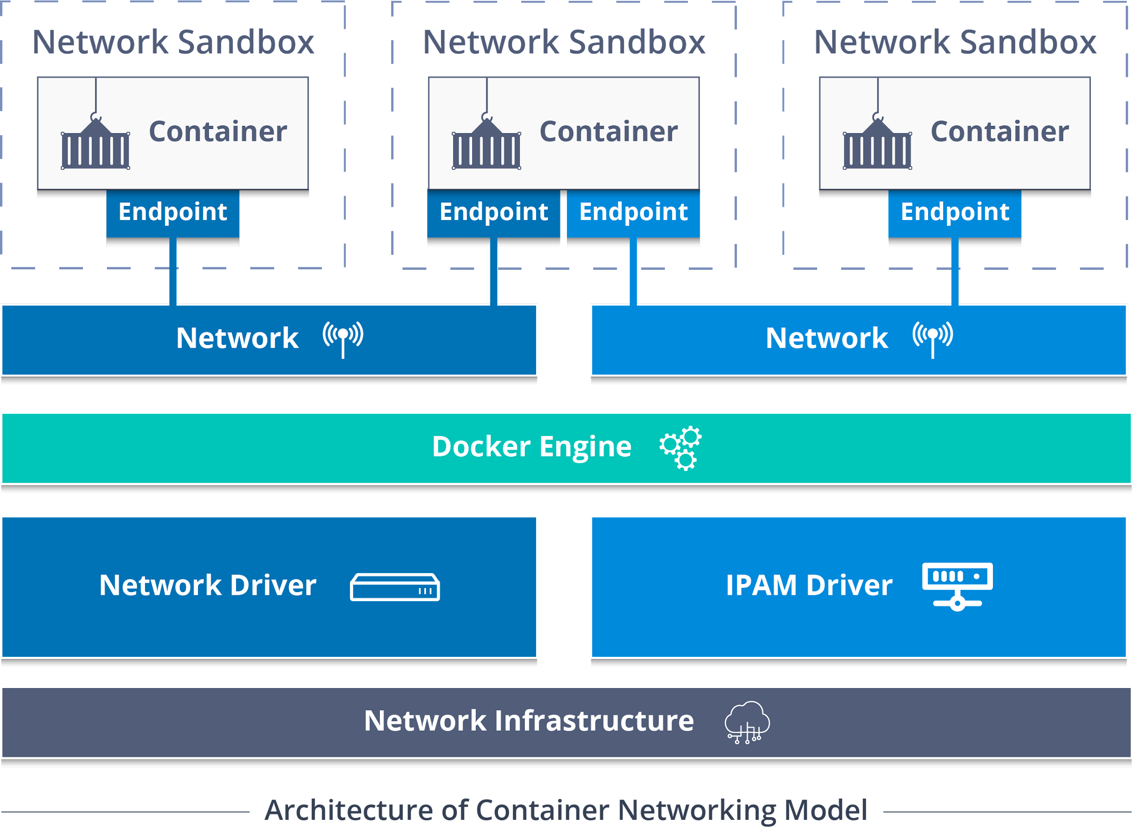
Container Network Module(CNM)

Slide 5
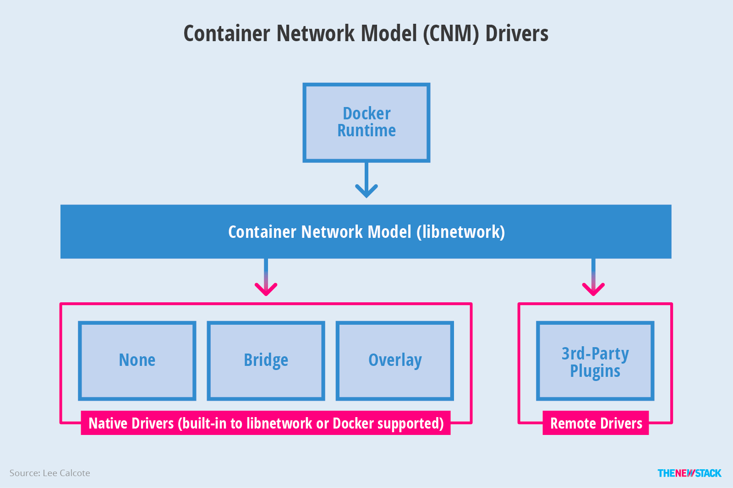
CNM driver

Slide 6
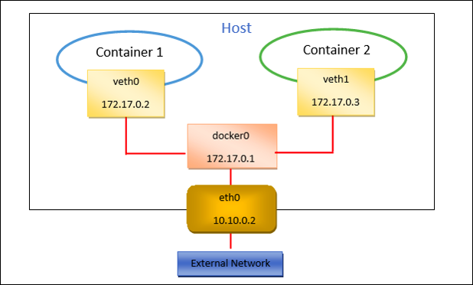
Single host container networking
Solution: Linux Bridge & IPtables

Slide 7
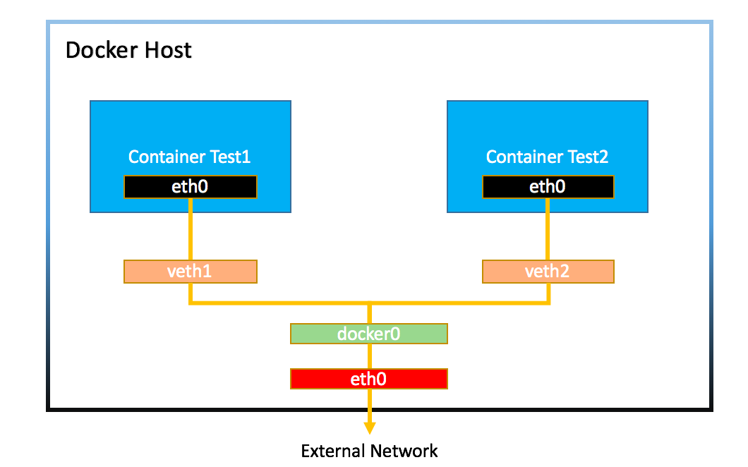
Notes:
doc.
https://docker-k8s-lab.readthedocs.io/en/latest/docker/bridged-network.html

Slide 8
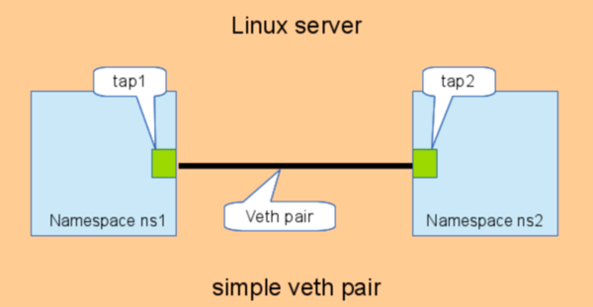
Linux network namespace

Slide 9
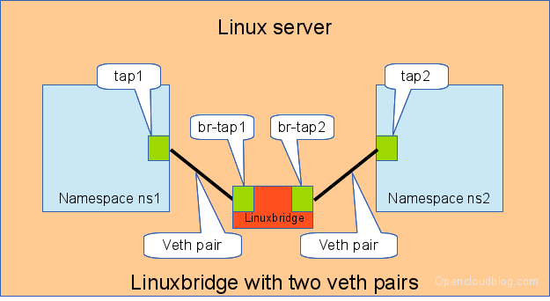
Notes:
https://www.itread01.com/content/1547377024.html
network namespce 與主機網路相連 => 創建vethpair=> 與主機網路是打通的

Slide 10
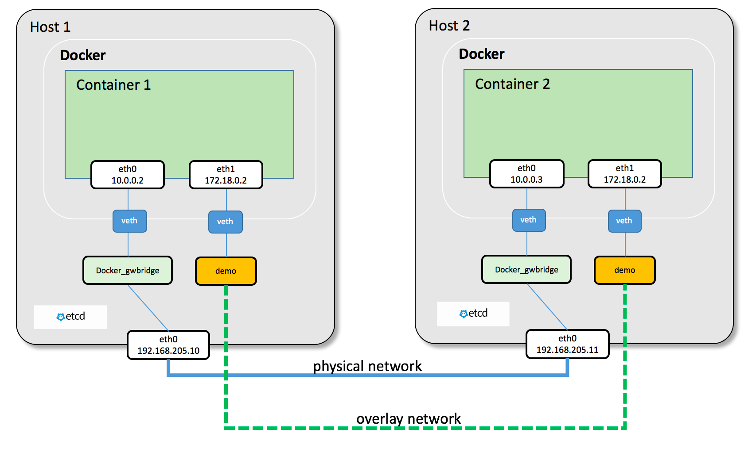
Multi-host container networking
Solution: Tunnel & Routing
Notes:
https://medium.com/@mohittalniya/overview-of-docker-networking-lets-connect-the-containers-39b34249ad91

Slide 11
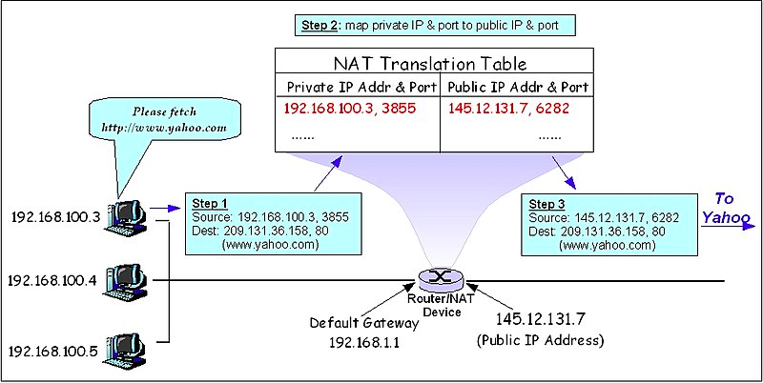
Network Address Translation(NAT)

Slide 12
